Slide 1


Derick Ansyijar Kuule
PhD Student
Department of Environmental Management, Makerere University
Supervisors: Anthony Egeru, Alice Turinawe & Barbara Schumann
Doctoral committee meeting presentation
27th/November/2024

Slide 2
Structure of the presentation
Key highlights of the Research Proposal
Preliminary Output/milestones
Current work (Second manuscript)
Ghent chat (Road map to 2026 Graduation)

Slide 3
Title: SOCIAL CONFLICTS DYNAMICS AND EFFECTS ON LIVELIHOODS IN THE PASTORAL AND AGRO-PASTORAL COMMUNITIES OF KARAMOJA CLUSTER
Main objective
To assess the drivers of social conflicts and their effects on livelihoods at household and community level based on the local contexts
Specifically the study will assess, objectives
Determinants of social conflicts
Determine the effect of social conflicts on asset accumulation
Explore the role of local institutions on social conflicts’ compromise and escalation

Slide 4
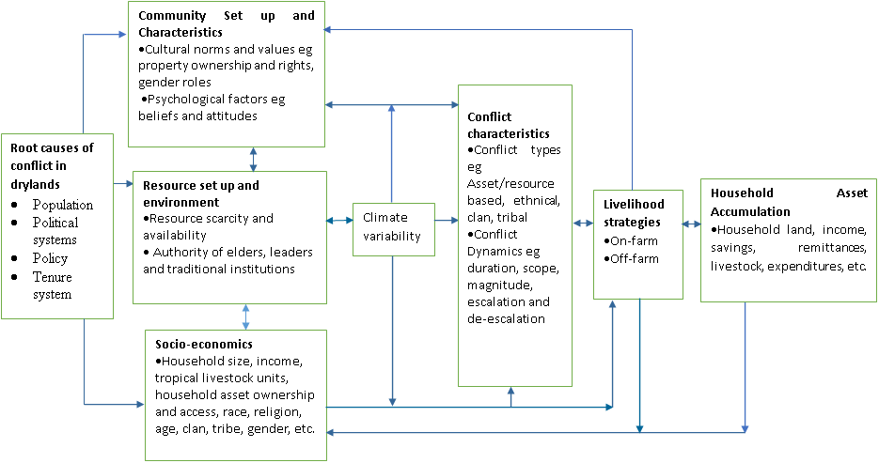
Conceptual framework

Slide 5
Table 1: Quantitative and qualitative data collection and analysis methods
Objective | Type of data to be collected | Data collection methods | Data analysis method | Study Approach
Objective 1: Determinants of social conflicts | -Forms of household and community-level conflicts -Socio-economic characteristics -Weather/climate data -In-depth data on community understanding of social conflicts, their drivers and seasonality | -Structured interviews. Baseline survey during the planting season Follow-up survey during post-harvest season Qualitative survey -Focus group discussions | -Descriptive statistics -Probit regression -Multivariate Probit Model -Thematic analysis | -Quantitative and qualitative

Slide 6
Summary of data collection and analysis cont’d
Objective | Type of data to be collected | Data collection methods | Data analysis method | Study Approach
Objective 2: Effect of social conflicts on asset accumulation | - Household demographics and assets to generate wealth index | -Structured interviews | -Asset-based wealth index Principal component analysis (PCA) -Fractional logistic regression model | -Quantitative
Objective 3: Exploring the role of local institutions on social conflicts compromise and escalation | -Local institutions roles in resolution and perpetuate social conflicts. -Membership in local institutions -Roles of local leaders | -Household survey to conduct structured interviews -Gender separated FDGs. Key informant interviews | -Multinomial logistic regression model -Thematic analysis and qualitative content analysis | -Quantitative and qualitative

Slide 7
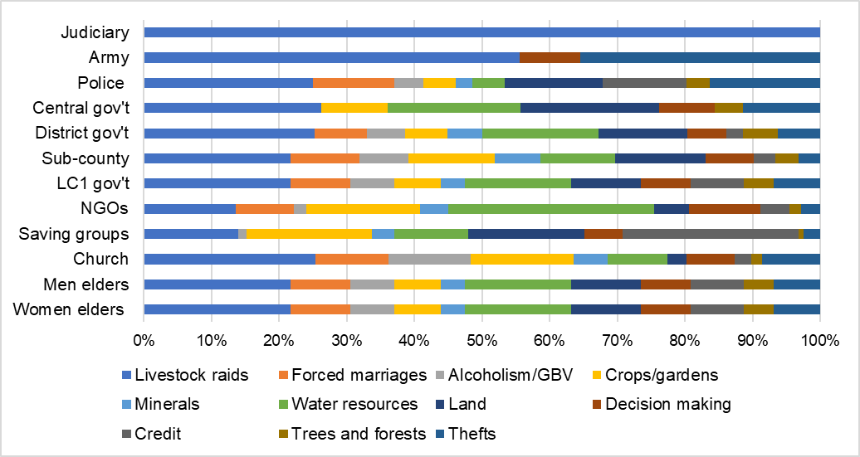
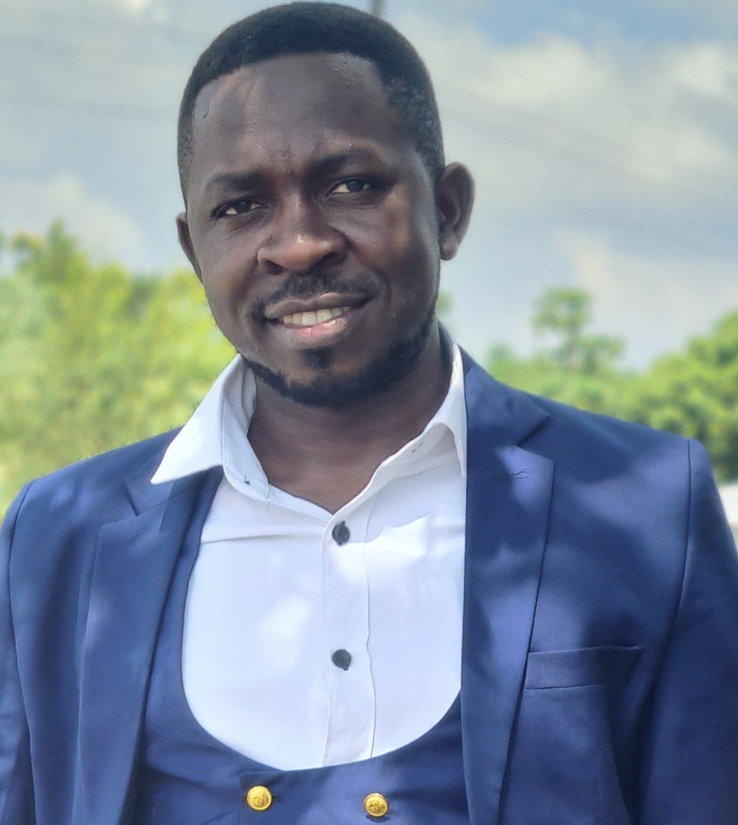


THE ROLE OF LOCAL INSTITUTIONS ON SOCIAL CONFLICTS IN THE KARAMOJA CLUSTER
Key Output
Conference Presentations
AGRI4D 2023 Poster
DevRES 2024
Poster
DERICK ANSYIJAR KUULE; KRISTINA LINDVALL; ALICE TURINAWE; AGNETA HÖRNELL; GÖRAN BOSTEDT; BARBARA SCHUMANN & ANTHONY EGERU
Conclusion
Conflicts on land, livestock, home labour, farm equipment and water resource have pofound effects on productivity and wellbeing of households.
There is a need to support collaborations between institutions and empower them with skills to foster proper management of social conflicts.
Introduction
Drylands in the Karamoja border region have been prone to social conflicts for the past five decades. Effects on agricultural productivity, the well-being of communities, and global and national agendas exist.
Aim
Formal and informal institutions’ roles in social conflict compromise and escalation were explored to support policy and decision-making.
Materials and methods
Participatory rural appraisal techniques eg Seasonal calendars
Gender-separated focus group discussions (FGD) and key informant interviews (KIIs)
Descriptive statistics and thematic analysis were conducted.
Figure 1: Perceived focus of institutions on different forms of social conflicts
Preliminary results
Informal institutions dialogue, negotiate and establish punishments.
Formal institutions conduct awareness creation, invest in infrastructure
Formal institutions mobilize resources for informal institutions
Emerging issues
Constraints in resources from formal institutions central to conflicts
Alleged collusion and vested interests among actors
Makerere University
Derick Ansyijar,Kuule
PhD student, Department of Environmental Management; P.0.Box 7062
E-mail: kulederrick@gmail.com
Phone: +256-700 117 550
Web: https://orcid.org/0000-0002-2564-0077
This preliminary analysis is going to be followed with a detailed analysis.

Slide 8


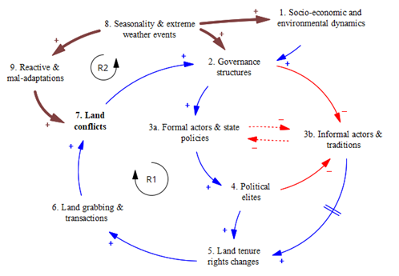



Submitted paper: Multi-dimensionality and interconnectedness of social conflicts in the Karamoja sub-region in northeastern Uganda
Methods and materials
Mixed methods approach
Female and male-separated FDGs
using rural participatory approaches
Findings
Five themes defined conflicts in Karamoja
Seasonal shifts in conflicts observed
Interlinkages
in conflicts
Conclusion:
Community perspectives unraveled great insights into social conflict patterns.
Seasonal dynamics and interconnected conflict drivers are worthy considerations for conflict interventions

Slide 9
Current paper: DETERMINANTS OF SOCIAL CONFLICTS IN NORTH-EASTERN UGANDA AND NORTH-WESTERN KENYA.
Type of Data | Data collection method | Data analysis method | Data source
Occurrence of social conflicts & determinants | Structured interviews | Binary response model (Probit) | Baseline and follow-up survey
Forms of social conflicts & determinants at community & Household level | Structured interviews | Multivariate probit regression Analysis | Baseline and follow-up survey
Seasonality of social conflicts | Satellite data and survey | Descriptive statistics | CHIPRS satellite rainfall data

Slide 10
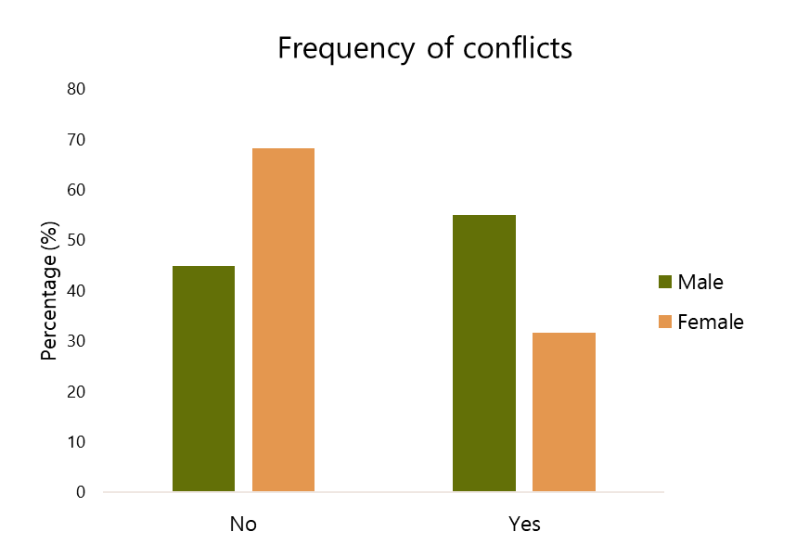
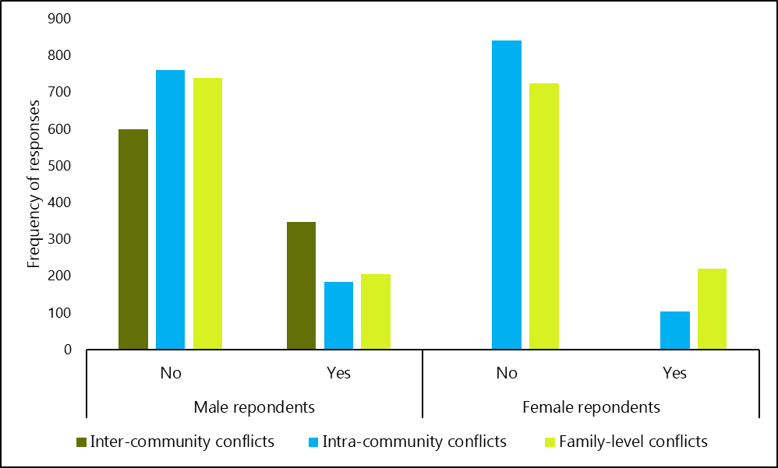
Preliminary findings

Slide 11
Results cont’d
Delta-method
Determinants of conflicts (Male) | dy/dx | Std. Err. | z | P>z
Study site (Matany)
Chepareria | -0.321 | 0.061 | -5.26 | 0.000
Lokiriama | -0.270 | 0.088 | -3.07 | 0.002
Rupa | 0.213 | 0.050 | 4.24 | 0.000
Marital status (Polygamous)
Single/never married | 0.116 | 0.118 | 0.98 | 0.325
Monogamous | -0.066 | 0.031 | -2.13 | 0.034
Separated/divorced | 0.176 | 0.148 | 1.19 | 0.234
Widow/widower | -0.128 | 0.079 | -1.62 | 0.106
HH type (Female headed) | -0.125 | 0.060 | -2.06 | 0.039
Family origin (Out of area) | -0.149 | 0.036 | -4.14 | 0.000
Wet season livestock land | 0.001 | 0.000 | 2.89 | 0.004
Migration with livestock (No) | 0.068 | 0.033 | 2.07 | 0.038

Slide 12
PhD Award Requirements
Thesis by publication: Social Conflicts Dynamics And Effects On Livelihoods In The Pastoral And Agro-pastoral Communities Of Karamoja Cluster
Two publications
1. Multi-dimensionality and interconnectedness of social conflicts in the Karamoja sub-region in northeastern Uganda
2. Determinants of social conflicts in north-eastern Uganda and north-western Kenya.

Slide 13
WAY FORWARD
Date | 1st Manuscript (Dimensionality & interconnectedness of social conflicts in Karamoja Sub-region northeastern Uganda) | 2nd Paper (Determinants of social conflicts in northeastern and northwestern Uganda) | 2nd & 3rd objectives analysis | Thesis, writing corrections and eidts, presentation at department, school, corrections | Thesis submission for examination | Viva; Thesis final edits and Final submissions
July-August 23
Sept -Dec 23
Jan-24
Feb-March 24
April-June 24
July-Aug 24
Sept-Dec 24
Jan-Feb-25
March-May 25
June-Aug 25
Sept-Nov 25

Slide 14
Request from the Doctoral committee
Comment on the academic performance and progress
Evaluate and comment on the quality of the work/research
Provide advice and guidance

Slide 15
Admission Timelines
Provisional admission: Effective 10th/August/2022 to 10th/August/2023
Full Admission: Effective 10th/July/2023 to 11th/July/2026
Drylands Transform Project Sponsorship: May 2022 to May 2025

Slide 16
Acknowledgment
The Supervisors
The Doctoral Committee Members
Drylands Transform Project
Thank you

